Slide 1

Hacking Metaploitable3

Slide 2

What is Metasploitable?
Metasploitable is a computer security project which contains a vulnerable machine and websites.
It allows people to attack a system without any legal repercussions, and aids Pen Testers in practicing “ethical” hacking.

Slide 3
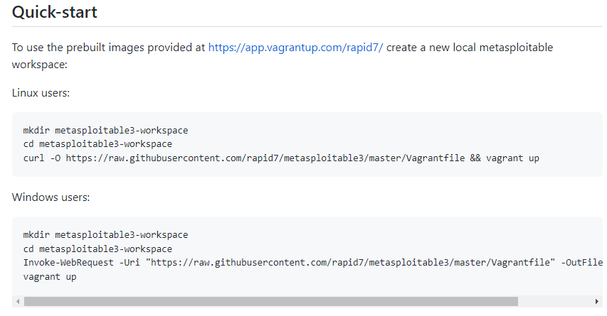
Metasploitable3 Setup & Configuration
On Linux, open a terminal and run the commands listed below (same applies to Kali Linux, which I prefer due to the vast amount of tools).
On Windows, open PowerShell and run the commands listed below. These commands & more can be found at https://github.com/rapid7/metasploitable3#quick-start *Note - The VM for Metasploitable will be created in Oracle. Windows Users may need to restart Oracle in order to make the VM appear.

Slide 4
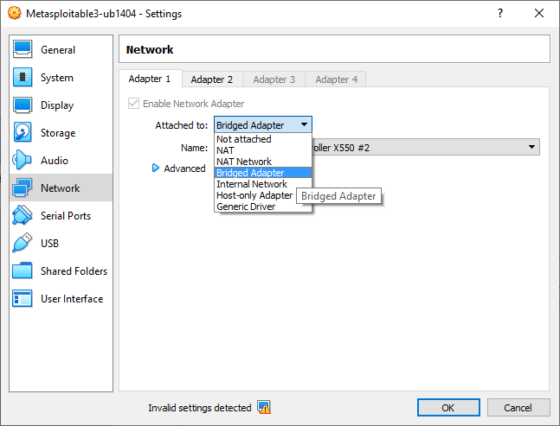
Metasploitable3 Setup & Configuration
Be sure to change the VM Network Settings from NAT to Bridged, ensuring that the VM is reachable from any home device.

Slide 5
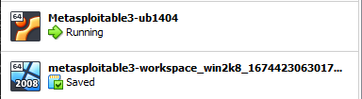
Metasploitable Setup & Configuration
You should now see the VM appear in Oracle *Note - There will only be 1 VM if you chose 1 Operating System. 2 is not required and is merely shown for example.
Linux VM
Windows VM

Slide 6
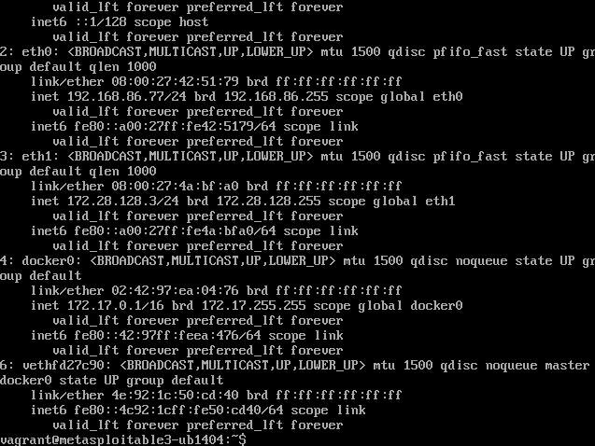
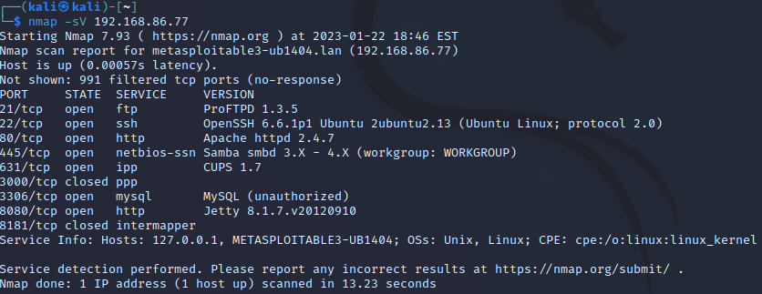
Metasploitable Setup & Configuration
Load the Metasploitable VM, and type ‘ip addr’ to confirm the IP. *You must SSH into the Metasploitable VM in order to attack it. - Type ssh vagrant@<eth0 ip>
Next, load up your private VM which you’ll be attacking from, and open a terminal. Here, you can run a ‘nmap scan’ to verify the ports open, and what can be exploited. *Note - ‘nmap -sV’ will show details of the ports

Slide 7



Slide 8
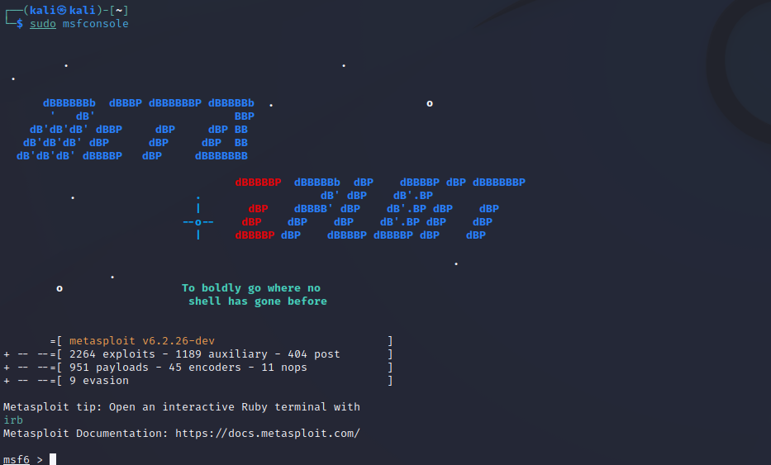
Beginning the Attack
I recommend using Kali Linux to have all the hacking tools one would need. Below, you will see MSFVenom being loaded up to begin attacking the Metasploitable Network.

Slide 9
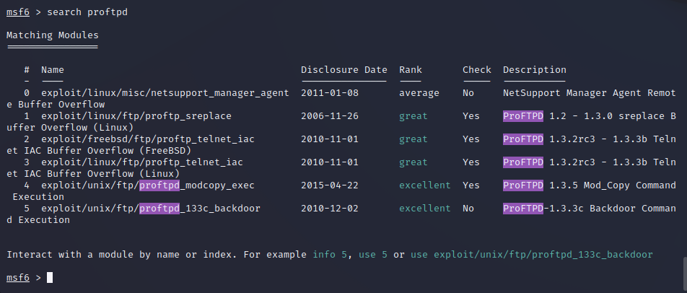
ProFTPD Attack
The first attack I chose was on Port 21, which utilizes FTP and ran version ProFTPD 1.3.5
ProFTPD is a FTP server, and one of the most popular FTP servers for Microsoft and Unix-like systems.
I began the attack by searching for ProFTPD in MSFVenom, and chose option 4 to carry out the attack.

Slide 10
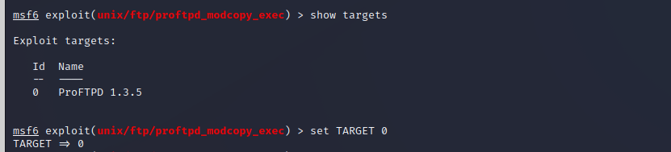
ProFTPD Attack
To ensure I fill in all required fields, I entered ‘show options’ to see what was necessary.
First required field was to set the RHOSTS to 192.168.86.77
Re-type ‘show options’ to confirm the entry.
Next, we need to see the target/s available, and set the target.
Re-type ‘show options’ to confirm the entry.

Slide 11
ProFTPD Attack
In order to create a reverse shell, a proper payload must be entered into the exploit options. I chose to use the ‘cmd/unix/reverse_perl’ payload, which is common for reverse shell attacks.
Re-type ‘show options’ to verify the entry. It’s very important to double check your work to ensure a successful attack!
Set the LHOST to your IP for the reverse shell.
As always, type ‘show options’ to verify the LHOST.

Slide 12

ProFTPD Attack
Set the ‘sitepath’ to gain access to the root folder for the web server. In this case, that was /var/www/html
Re-type ‘show options’ to verify the entry.

Slide 13
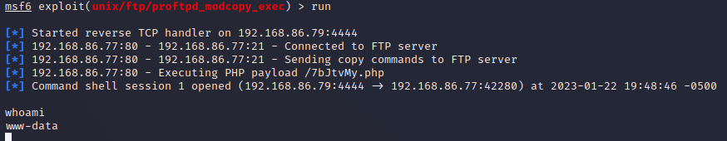
ProFTPD Attack
Type ‘run’ to send the exploit into action!
You can see at the bottom I ran ‘whoami’ to ensure I made it in successfully!

Slide 14
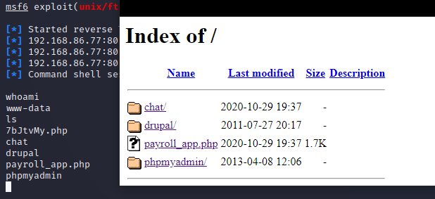
ProFTPD Attack
To double check the attack landed and was successful, I typed ‘ls’ to view the contents of where I entered in the reverse shell, and verified that with the Metasploitable Site.

Slide 15



Slide 16

A Failed Attempt at Searching for an Exploit
Failed attacks are prone to happen, and this should make us confident that the proper updates are being creating to ensure our safety.

Slide 17
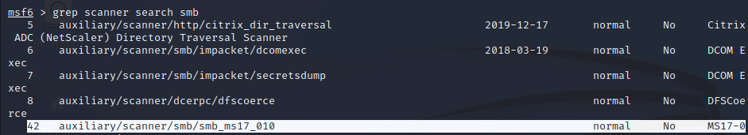
SMB_MS17_010 Attack
I attempted to find an exploit in Port 445 which is for TCP/IP/SMB.
SMB stands for Server Message Block, which is a network file sharing protocol that allows applications on a computer to read and write to files, and to request services from server programs in a computer network.
I began my initial search for a good exploit, and chose ‘smb_ms17_010’ - Microsoft published the issue on March 14th, 2017 explaining the vulnerability allowed Remote Code Execution, and it was rated as a Critical Vulnerability.

Slide 18
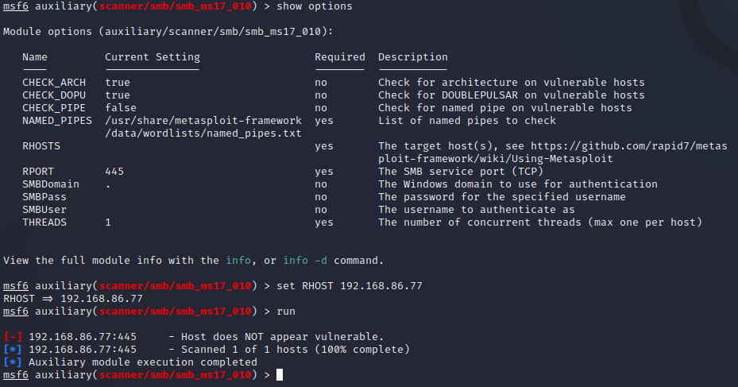
SMB_MS17_010 Attack
I typed ‘show options’ to see what was required to carry out the exploit, and all it needed was the RHOST to be set.
After setting the RHOST to 192.168.86.77, and running the exploit, it returned that Metasploitable was NOT vulnerable and had been previously patched.

Slide 19


Slide 20

Summary of the ProFTPD Attack
Keeping in mind that Port 21 is a very commonly used port for Microsoft and Unix-like servers, it could be a early point of attack for a malicious user. FTP is a standard communication protocol used for file transfers between a client and the server, also found on the Application Layer 7 of the OSI model. While being a crucial part of a business or network, it’s imperative that it’s properly protected and monitored. Being able to gain access to the /var/www/html folder allows the malicious user to have free reign to the data and copy any file on the FTP server, or possibly upload malicious files, which could cripple a business or website.

Slide 21
Mitigation for the ProFTPD Attack
The first option to preventing the ProFTPD attack would be to disable FTP all together. If that’s not an option, disabling anonymous FTP connections would be the next step. Limiting access to FTP is another idea, setting up restrictions for which IP addresses within the network can have access to FTP. This can be done using the ‘/etc/proftpd/proftpd.conf’ file and including one or more ‘Allow’ clauses to identify where FTP access should be granted.
Secondly, there is a program called ‘Fail2Ban’ which can detect failed login attempts and automatically block the source IP address. One can configure this program to a set number of failed FTP login attempts, as well as blocking the source IP for a designated period of time.

Slide 22


